Slide 1
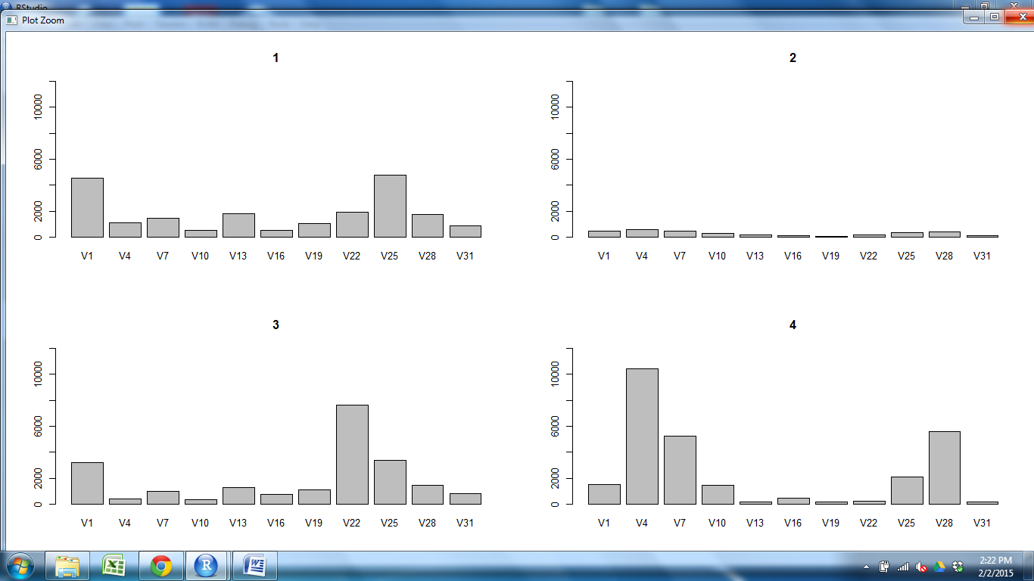
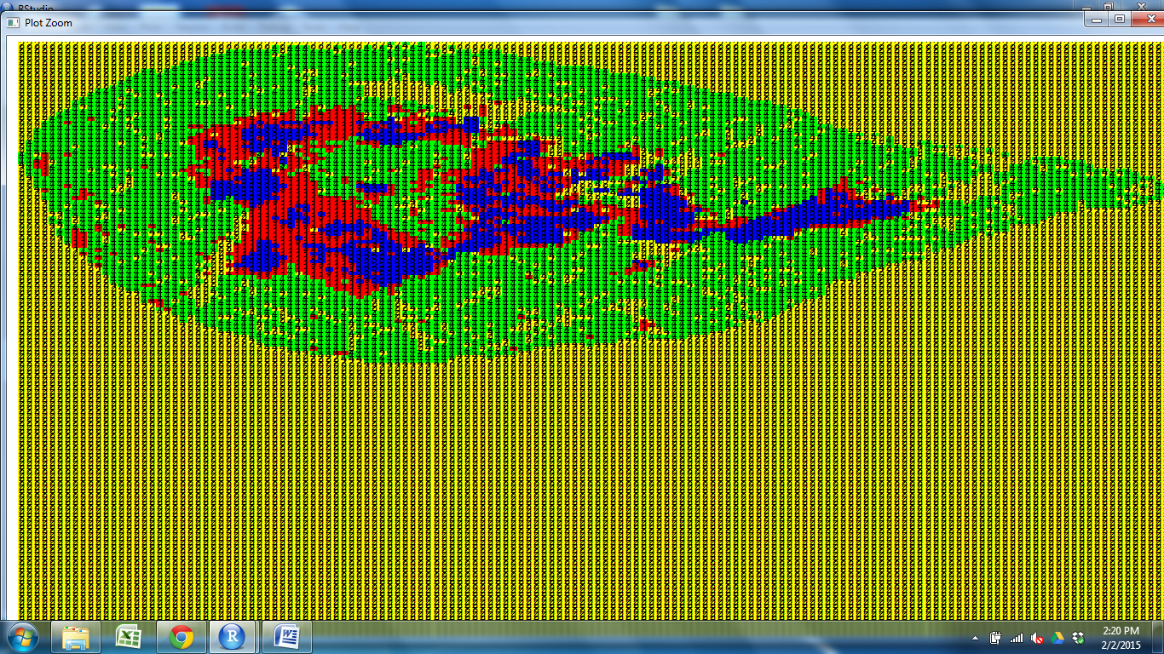
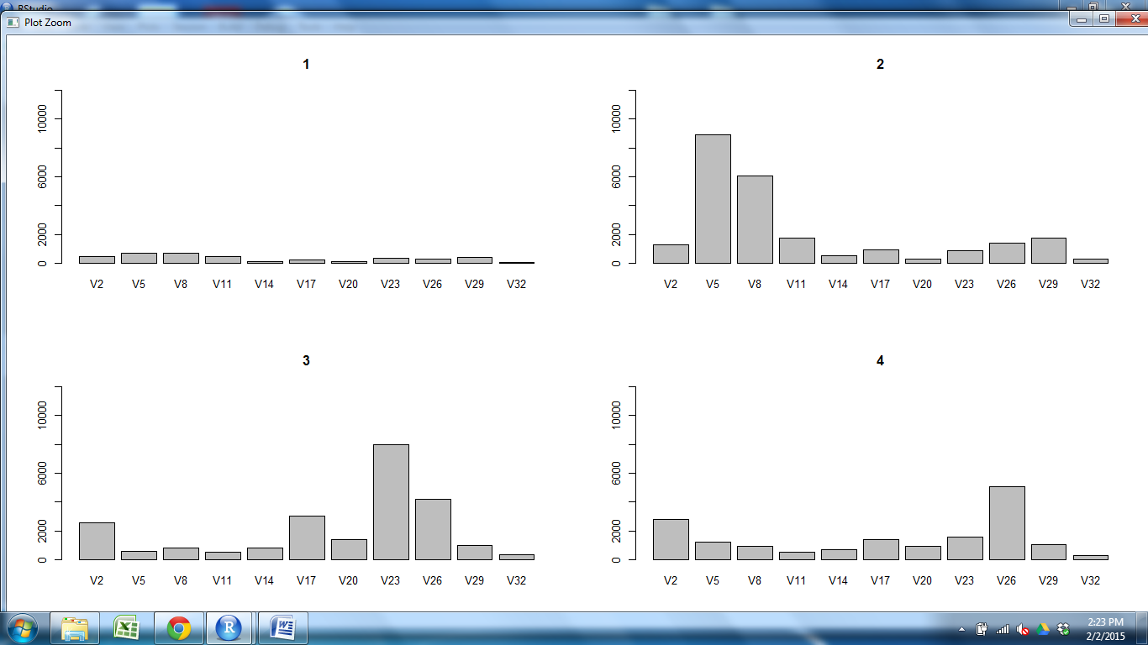
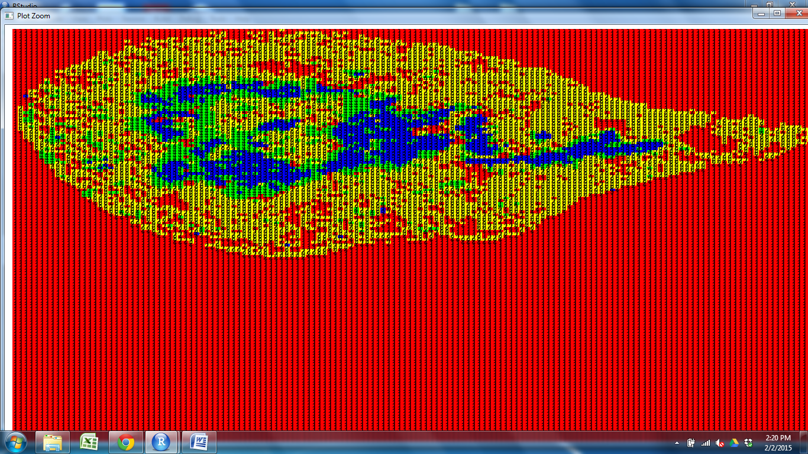
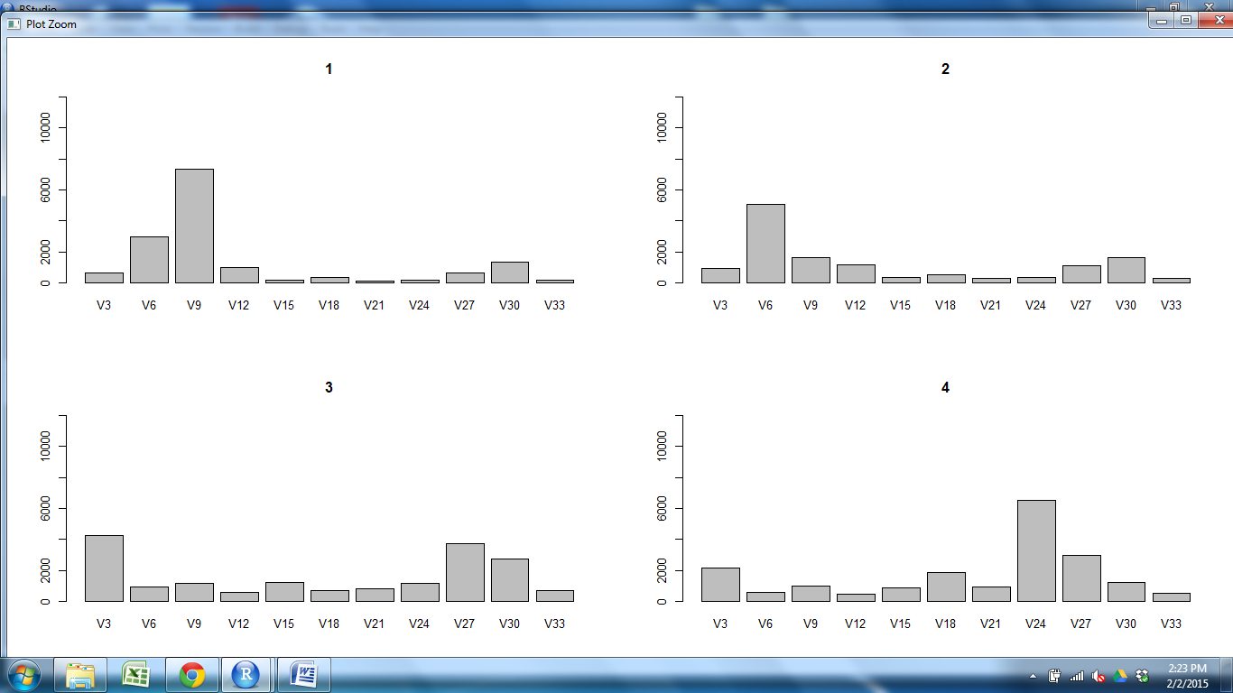
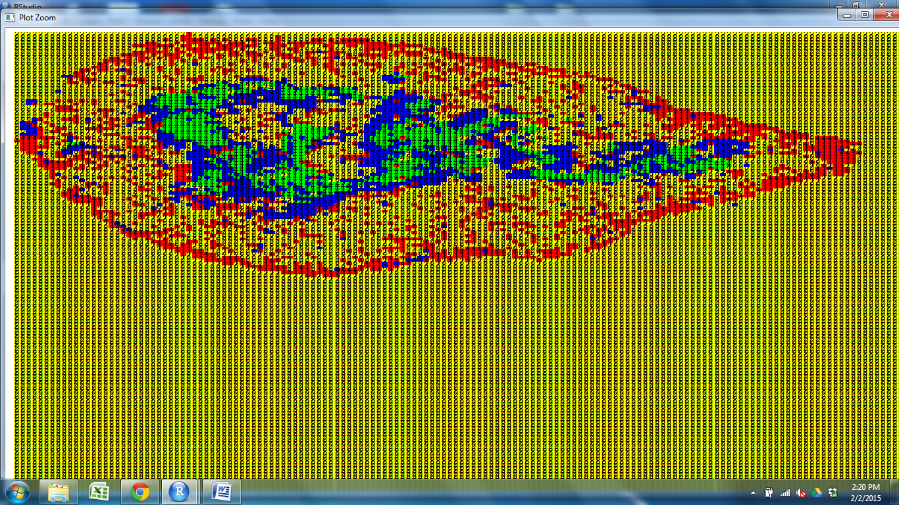
CD11c CD25 CD31 CD205 Claud5 Claud34 Foxp3 K5 K14 PDGFRb UEA1

Slide 2
CD11c CD25 CD31 CD205 Claud5 Claud34 Foxp3 K5 K14 PDGFRb UEA1

Slide 3
CD11c CD25 CD31 CD205 Claud5 Claud34 Foxp3 K5 K14 PDGFRb UEA1

Slide 4
CD11c CD25 CD31 CD205 Claud5 Claud34 Foxp3 K5 K14 PDGFRb UEA1

Slide 5
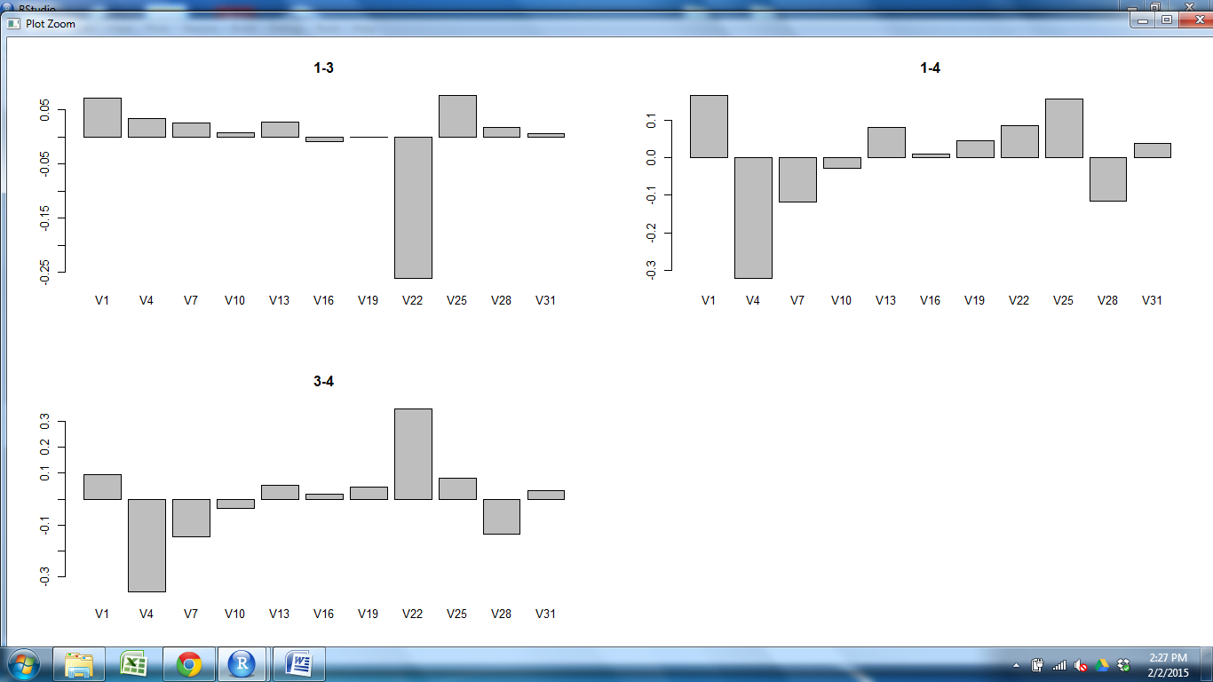
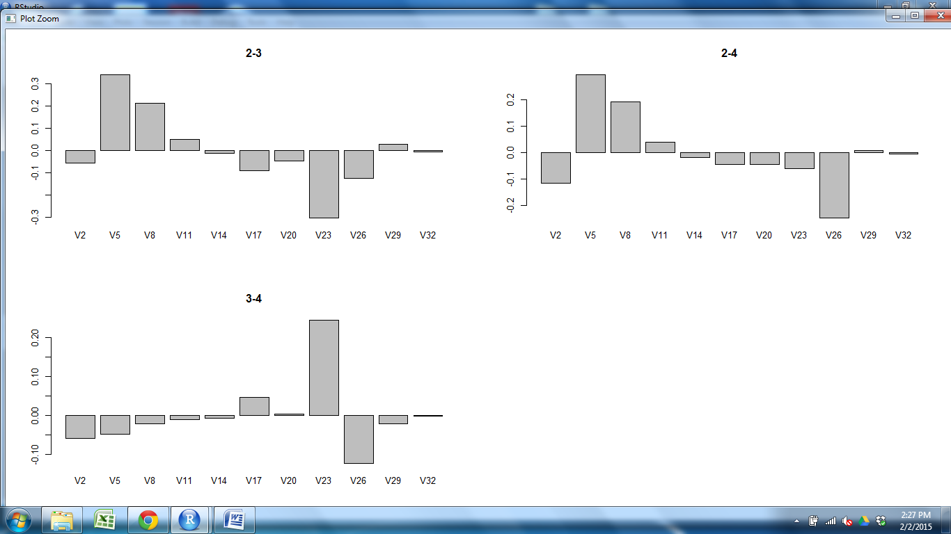
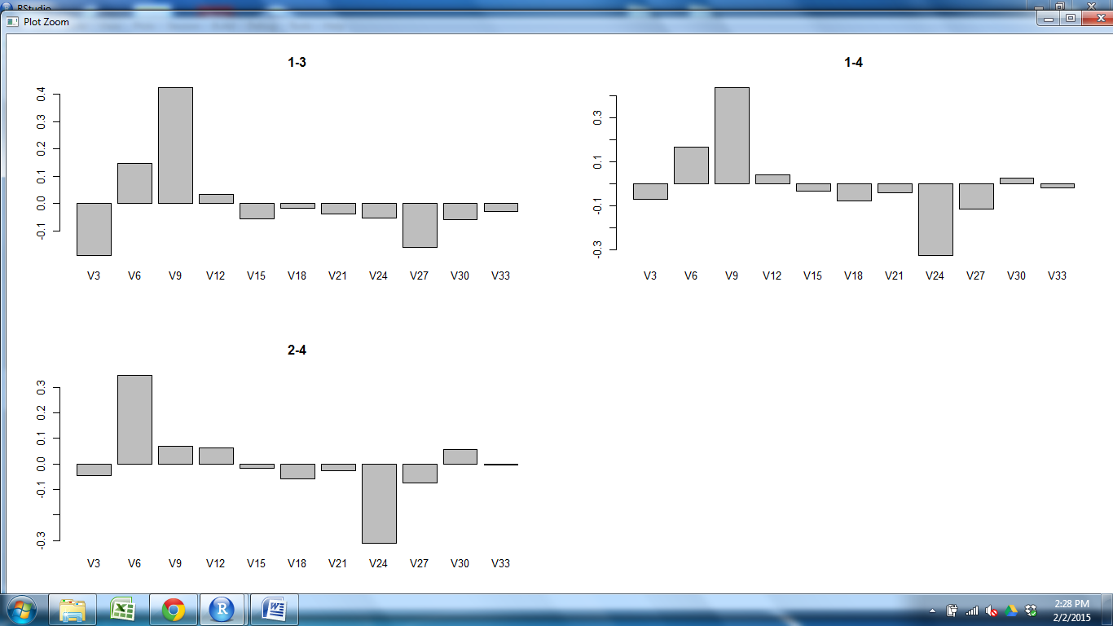
CD11c CD25 CD31 CD205 Claud5 Claud34 Foxp3 K5 K14 PDGFRb UEA1
Cortex vs M1

Slide 6
CD11c CD25 CD31 CD205 Claud5 Claud34 Foxp3 K5 K14 PDGFRb UEA1
Cortex vs M2

Slide 7
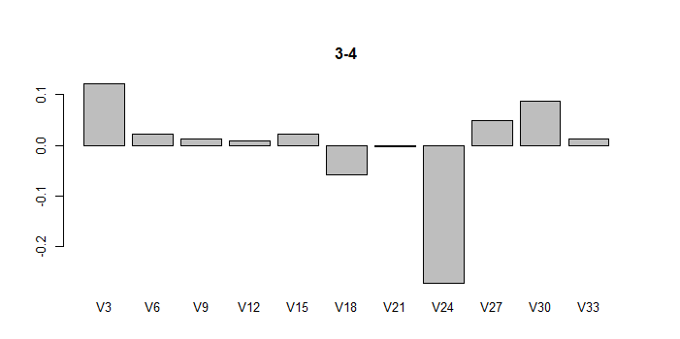
CD11c CD25 CD31 CD205 Claud5 Claud34 Foxp3 K5 K14 PDGFRb UEA1
M1 vs M2

Slide 8
